Slide 1
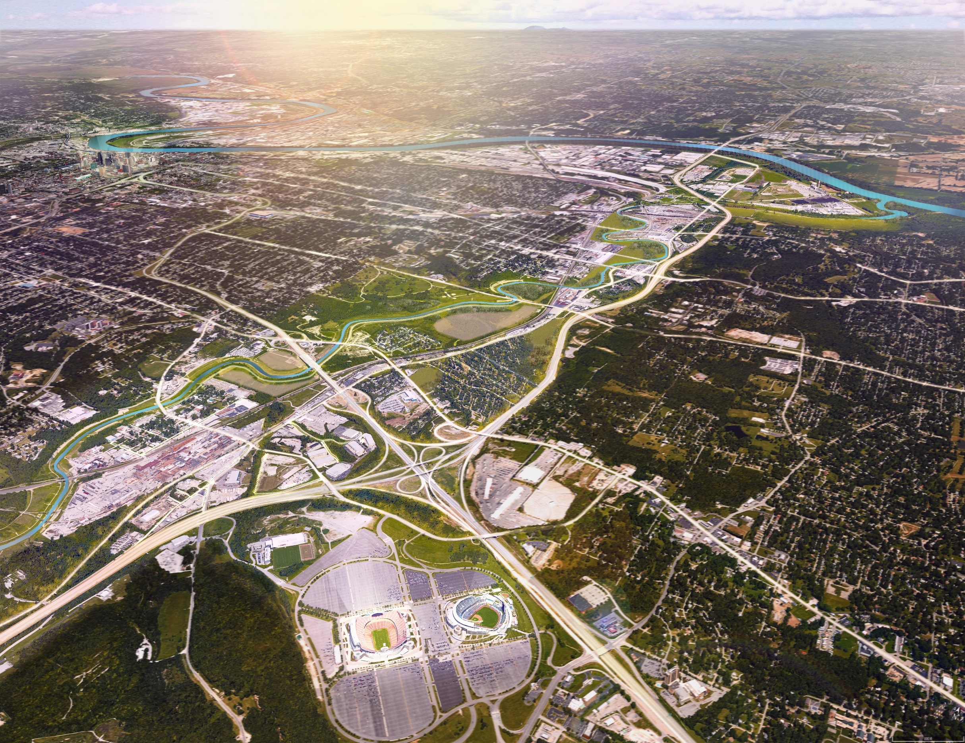





Blue Valley Redevelopment Opportunity Assessment
Executive Summary
August 2017

Slide 2
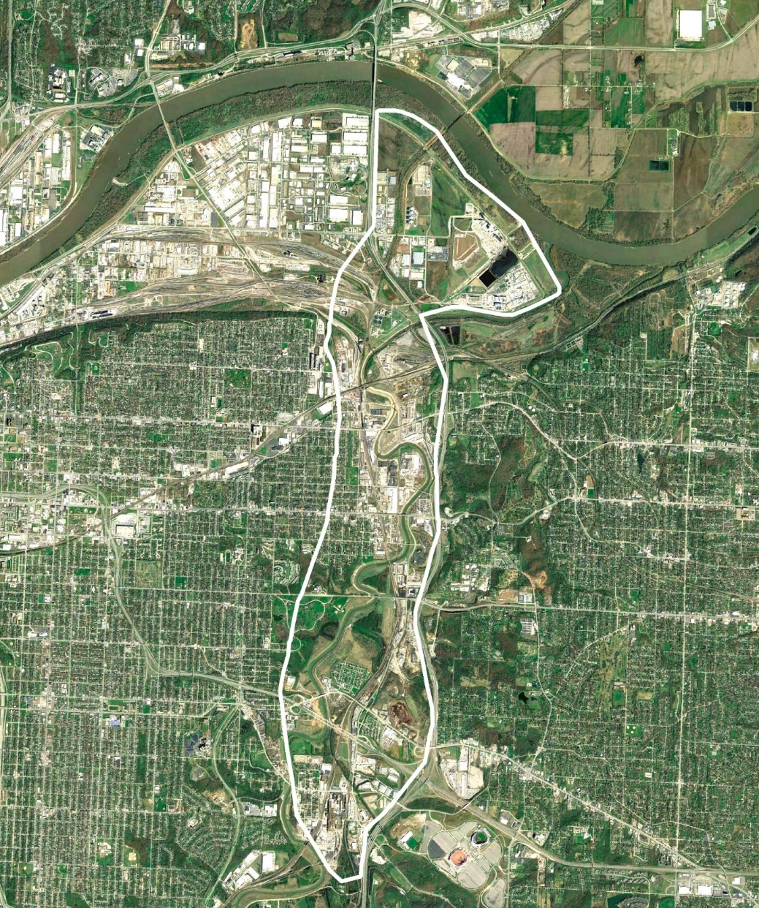
Redevelopment Opportunity Assessment | Vision, Strategy, and a Roadmap for Action
Restore
economic activity to the Blue Valley Industrial Corridor to grow jobs & benefit local communities

Slide 3
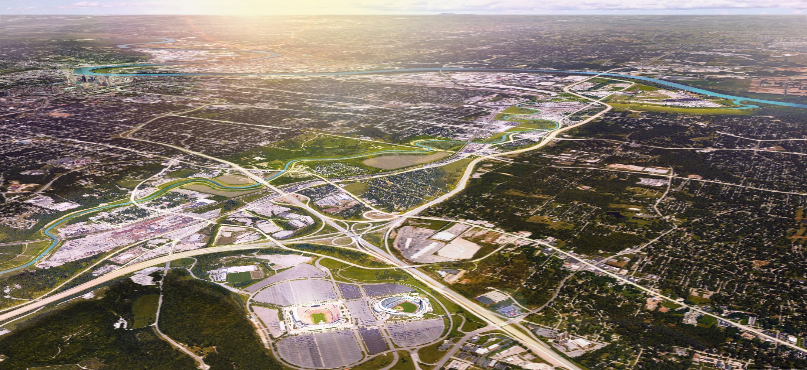
The Blue Valley Industrial Corridor Vision
Kansas City’s most sustainable, multi-modal collection of manufacturing clusters, with natural and employment connections that support the community and economic development of Kansas City’s East Side

Slide 4
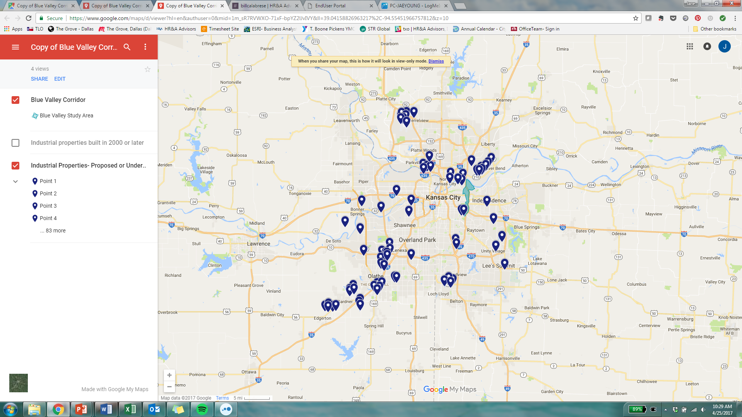
An Opportunity within a Thriving Regional Industrial Market
Industrial Properties Proposed or Under Construction
8.7M SF
Industrial Space
Delivered in 2016,
Metro Area
5.5M SF
Industrial Space
Under Construction,
Metro Area
113K
Potential Employees within
15-minute drive,
Blue Valley
Source: CoStar

Slide 5
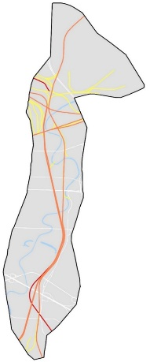
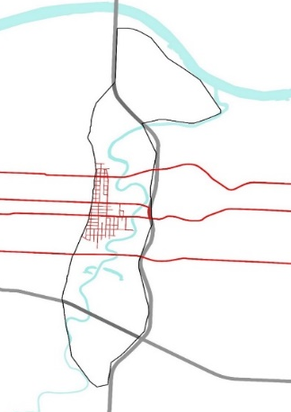
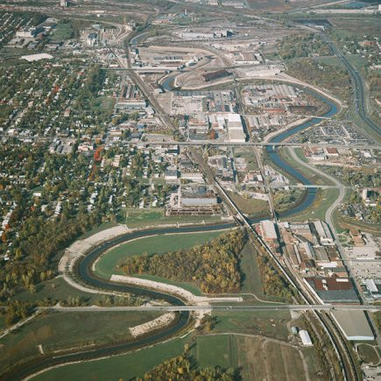
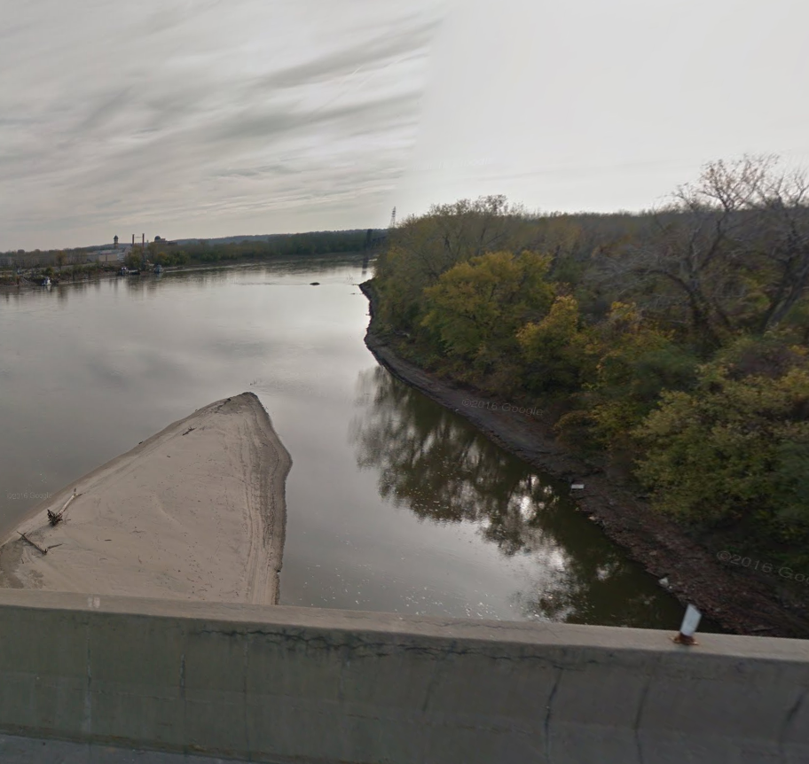
Blue Valley Opportunities & Assets
Industrial Infrastructure
Location & Access
Manufacturing Focus
Recent Investment & Assets
Natural Amenities
420 acres
rail right-of-way
15-minutes
from downtown
KCMO
~50%
building area in manufacturing use
$290 million
floodway improvements completed
134 acres
existing trails & parks
2
major interstate highways
~460 Acres
planned food manufacturing / ag facilities near Blue Valley
2.5 miles
of Missouri River frontage
High-capacity
utility service
$1.33 billion
recent public & private investment, Industrial Riverfront area
$15 million+
total annual compensation
Industrial
Other
Rail Network
Road Network
MSA Jobs
Flood Control
Missouri River
Notes:
Image: Blue River Channel Project
https://www.army.mil/article/175129/after_three_decades_blue_river_corridor_flood_risk_management_project_complete

Slide 6
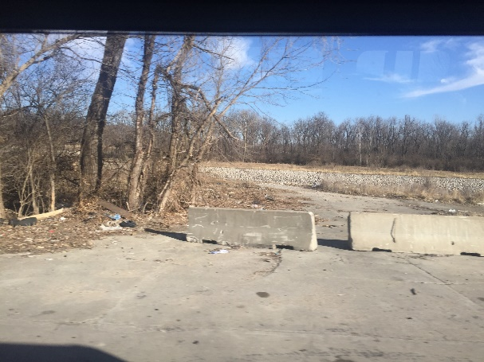
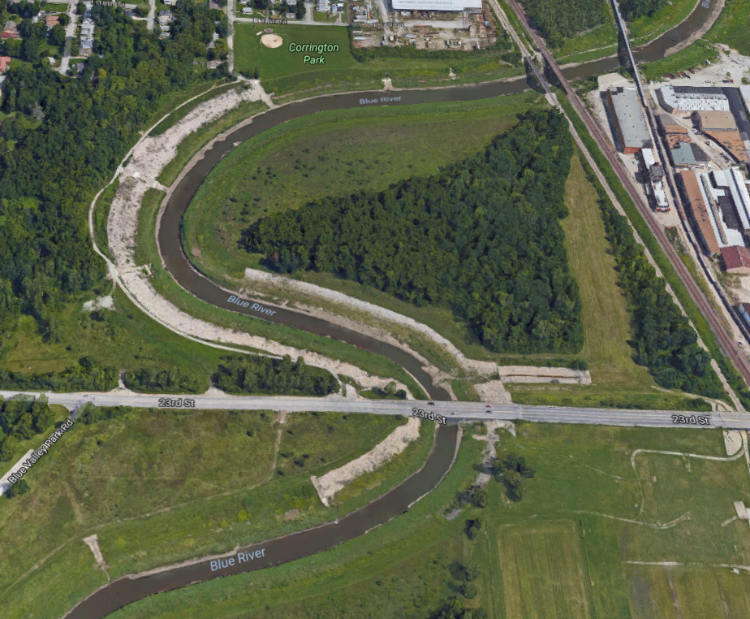






Blue Valley Challenges
Incomplete Connectivity
Environmental Conditions
Flooding Risk
Development Costs & Risks
Limited Focused Capacity
Limited transit
through Blue Valley corridor
60+ sites
in MDNR database
1,500 acres
in 100-year floodplain
50%+ higher
property, income, and utility taxes relative to region
8+
partner organizations on advisory committee
Unknown
Environmental conditions on many sites
2+ miles
Blue Valley corridor not served by Trafficway
1/3 of area
in floodplain
0
paid staff dedicated to Blue Valley efforts
20-60% lower
rents relative to competing locations
Out
Road Obstacles
Contamination
Flood Risk
Development Econ.
Partners
Notes:
Development economic icon (Arthur Shlain): https://thenounproject.com/ArtZ91/collection/finance/?oq=cost&cidx=2&i=649838

Slide 7
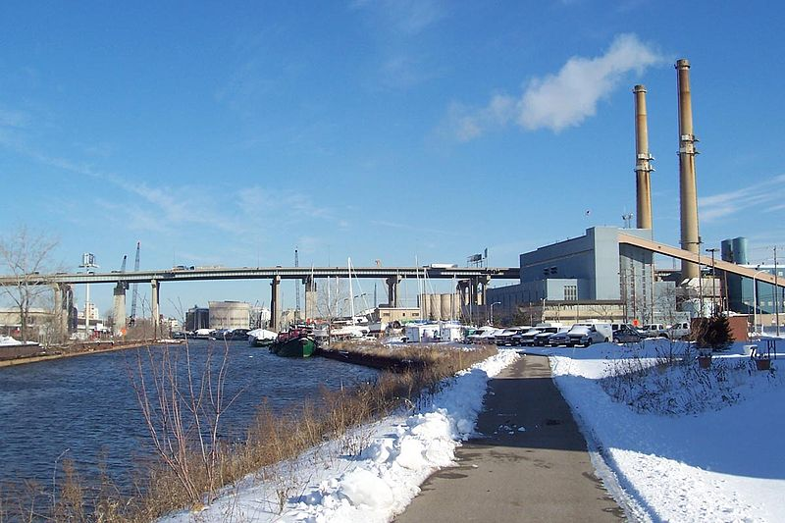
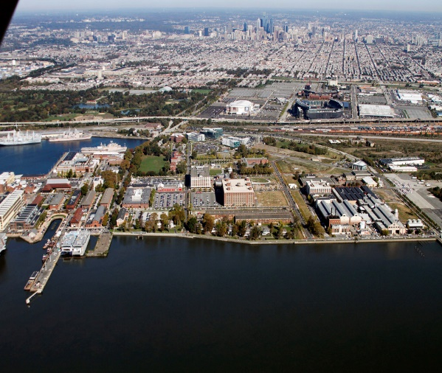
Industrial Revitalization Precedents
Menomonee Valley | Milwaukee, WI
Philadelphia Navy Yard | Philadelphia, PA
5K Jobs created
39+ Companies in Valley
12K Jobs created
150+ Companies at Navy Yard
Size: 1,200 Acres
Targeted Investments: Land use planning, environmental testing, trails and recreational amenities, access & bridge improvements
Select Incentives: Brownfield remediation, workforce development
Grants for brownfield assessment/ remediation; wage credits for employees living/working in defined area and deductions for property rehab
Project Steward: Menomonee Valley Partners (MVP), a 501(c)(3) non-profit, created to lead public-private collaboration for Valley redevelopment
Size: 1,200 Acres
Targeted Investments: Redevelopment of office space by attracting first major tenant (URBN), gateway improvements
Select Incentives: Workforce development, R&D, new business / tech incubation
Tax credits for specific targeted tech and R&D sectors; job creation tax credit
Project Steward: Philadelphia Industrial Development Corporation (PIDC), a public-private economic development corporation leading redevelopment
Notes:
Navy Yard (2015 in Review): http://www.navyyard.org/theyardblog/2016/02/12/pidc-reports-banner-year-at-the-navy-yard-in-2015-featuring-robust-growth-and-expansion/

Slide 8
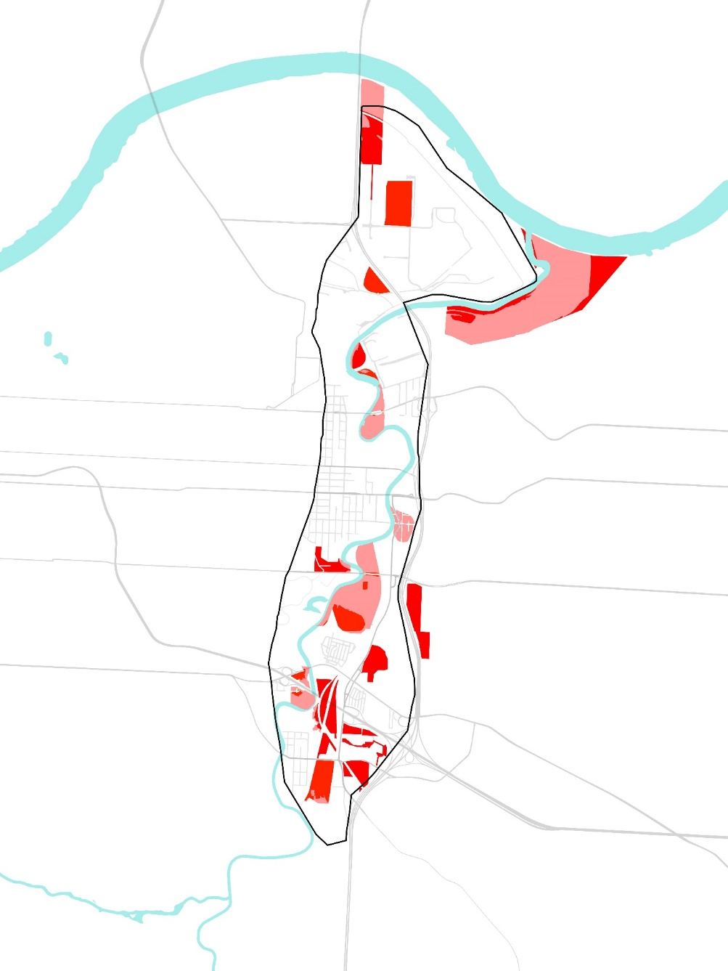
Opportunity Sites with Future Development Potential
Opportunity Site Criteria
Vacancy
Flood Risk
Public Ownership
Environmental Risk
Site Size
Access
560 Acres
Total site area
14
Opportunity Sites
~100 Acres
Publicly owned
~90%
Currently vacant
Sites Outside Floodplain
Sites in Floodplain

Slide 9
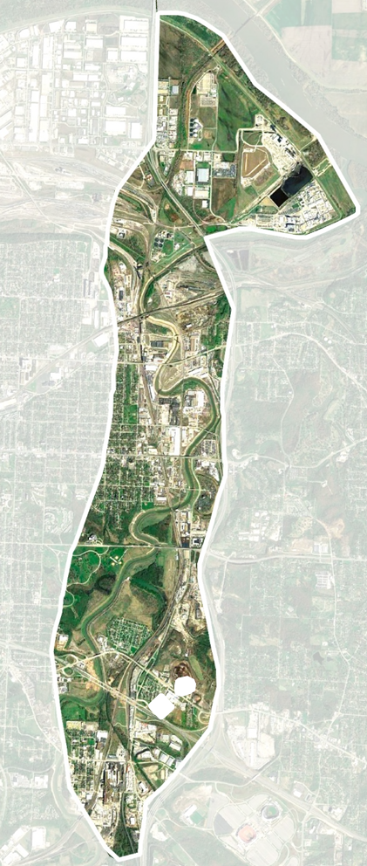
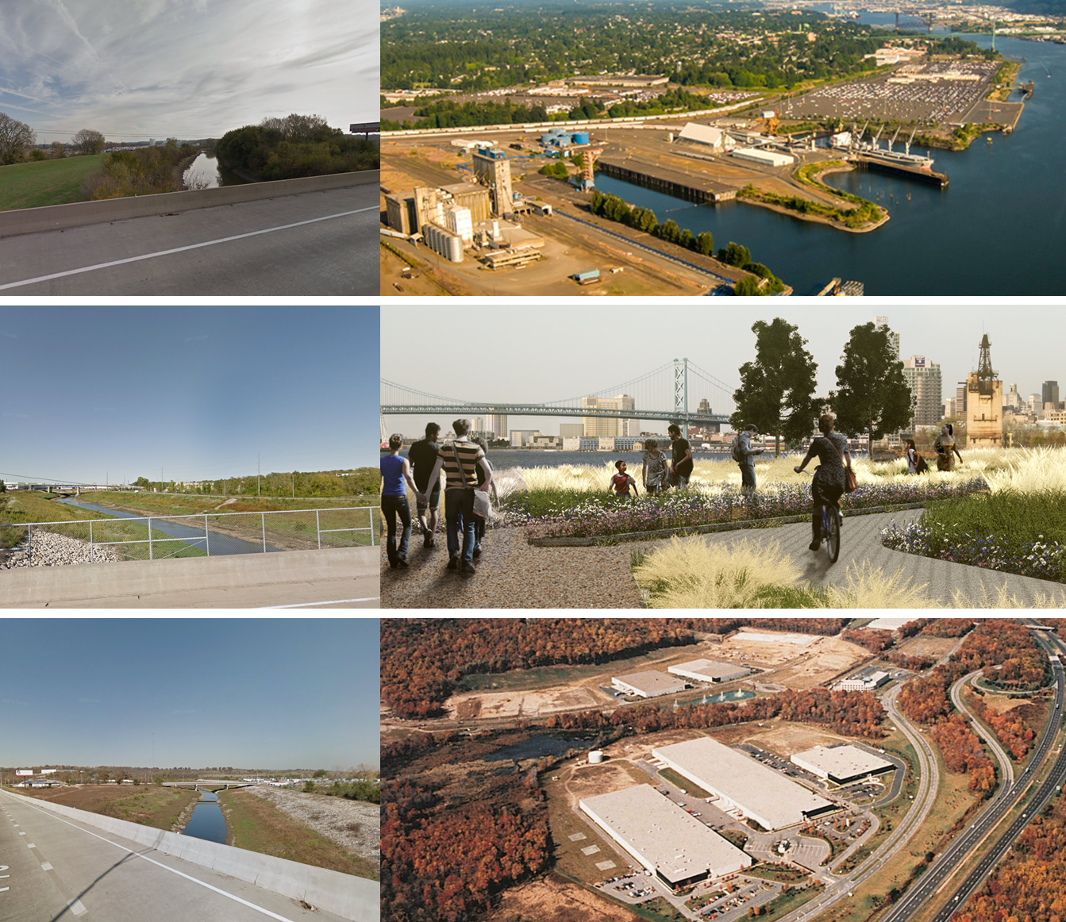
Segmenting a Large Corridor
North
Rail and The River
4,600 acres
7 square miles
Central
Neighborhood Transition Zone
South
Mixed Industrial

Slide 10
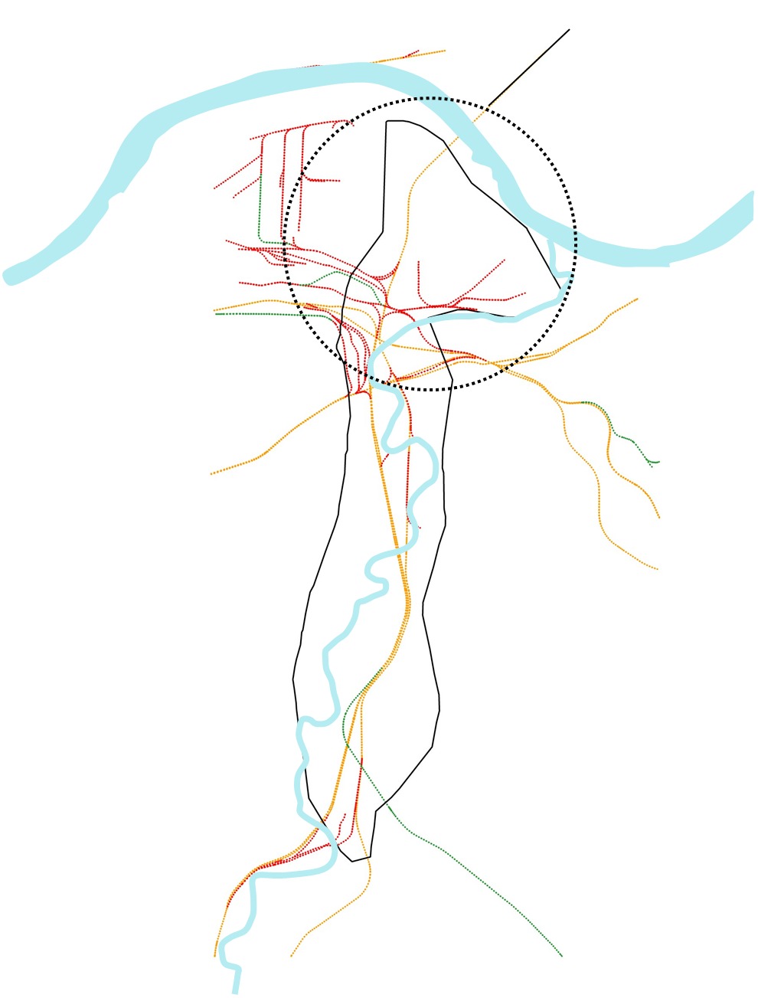
North Segment | River & Rail Access, but Deficient Road Network
Area
1,760 acres
Key Industries
Trucking, Logistics, Auto Parts & Repair, Agricultural Products
Key Needs
Access – address road deficiency
Assets – leverage rail & river access
Future Potential
Rail & River
Major road investment
Warehousing
Heavy industrial
Manufacturing & food industry

Slide 11
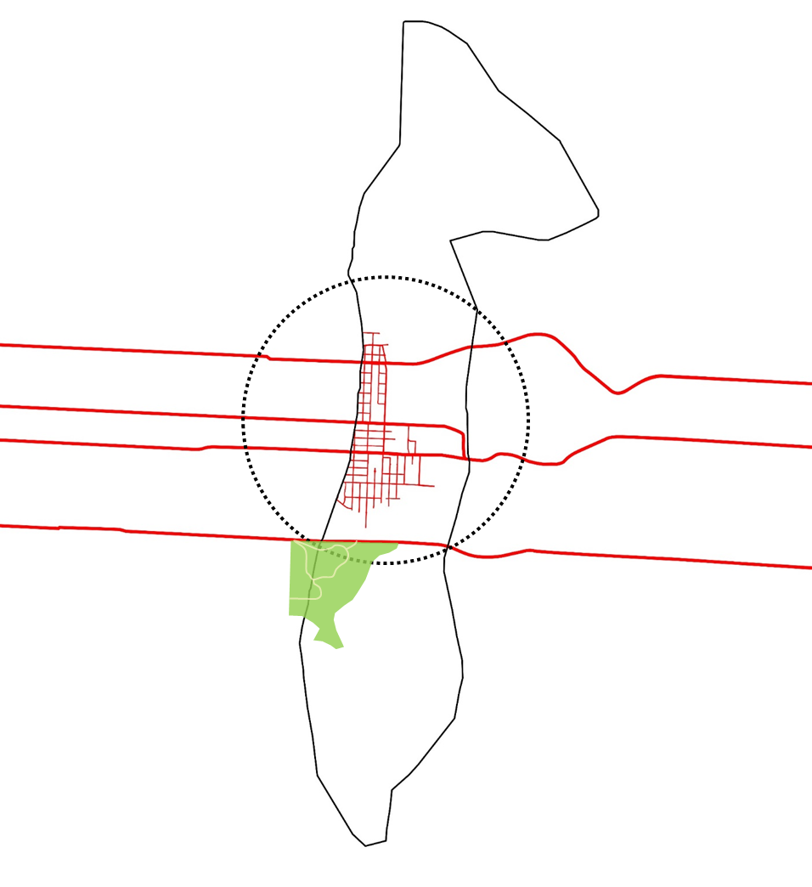
Central Segment | East-West Connectivity and Neighborhood Proximity
Area
1,220 acres
Key Industries
Warehousing, Material Handling, Equipment Rental, and Auto Salvage
Key Needs
Access – complete N/S access
Green – trails & parks
Streetscape – improve perceptions
Future Potential
Neighborhood Transition
Light industrial
Neighborhood development
Recreation

Slide 12
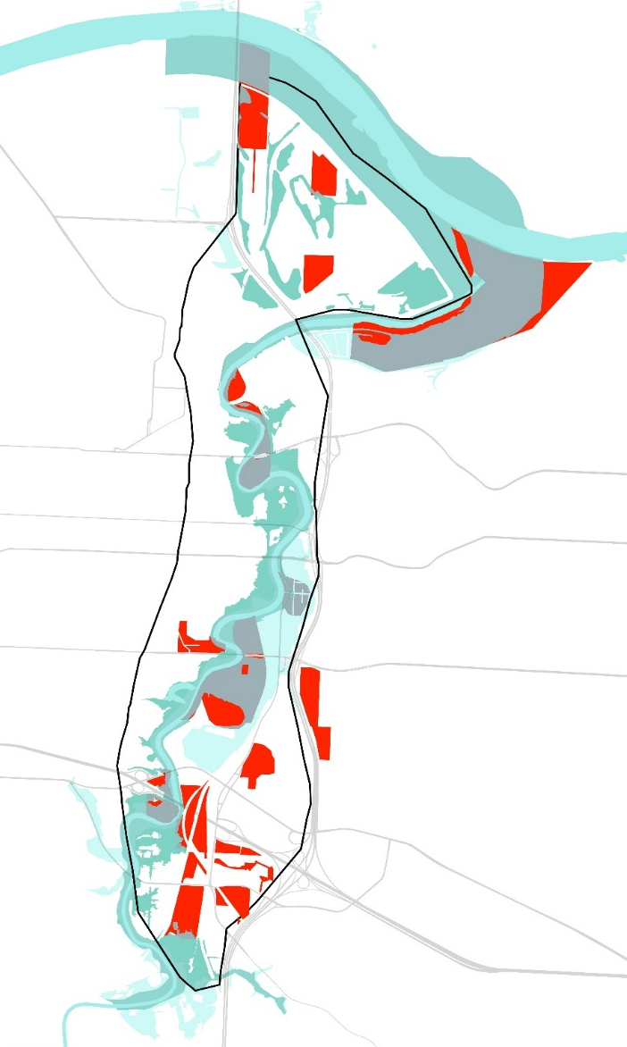
South Segment | Major Interstates and Opportunity Site Concentration
Area
1,620 acres
Key Industries
Recycling, Waste management, Equipment Rental, and Auto Parts & Repair
Key Needs
Access – connect opportunity sites to Trafficway
Future Potential
Mixed Industrial
Traditional Manufacturing
Artisan & Maker Space
Incubators
Agricultural & Food Production

Slide 13
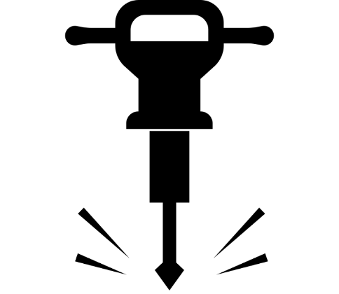

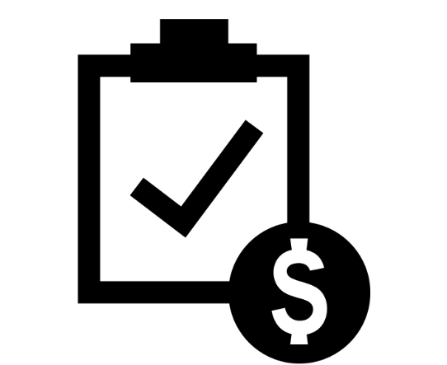
Implementation Approach
Create Value
Increase Visibility
Facilitate Development
Target Infrastructure Investment
Improve Communications & Perceptions
Minimize Risks
& Costs
Road infrastructure to complete missing links & unlock development
Improved workforce access
New open space
Streetscape improvements to improve perceptions
Strategic communication of assets & investments
Code enforcement to curb illegal dumping
Targeted incentives to attract investment
Public investment to reduce private sector risk

Slide 14
Create Value | Roads & Open Space
North Segment
Roads - $90M
Local & regional connectivity
16K LF neighborhood roads
11K LF Manchester Trafficway Extension
Lewis & Clark Expy
Lewis & Clark Extension
Central Segment
Parks & Green Space
Extend Manchester Trafficway
Neighborhood greening
183 acres new open space
Completion of proposed trails
South Segment
Roads - $30M
Opportunity site access
17K LF neighborhood roads
Source: Hg Consult Analysis

Slide 15
Create Value | Roads & Open Space
Target Infrastructure Investment
Lewis & Clark Extension
Phasing Considerations
South – unlock opportunity sites in near-term
North – longer-term regional projects
Central – long-term greening following current trail investments
Extend Manchester Trafficway

Slide 16
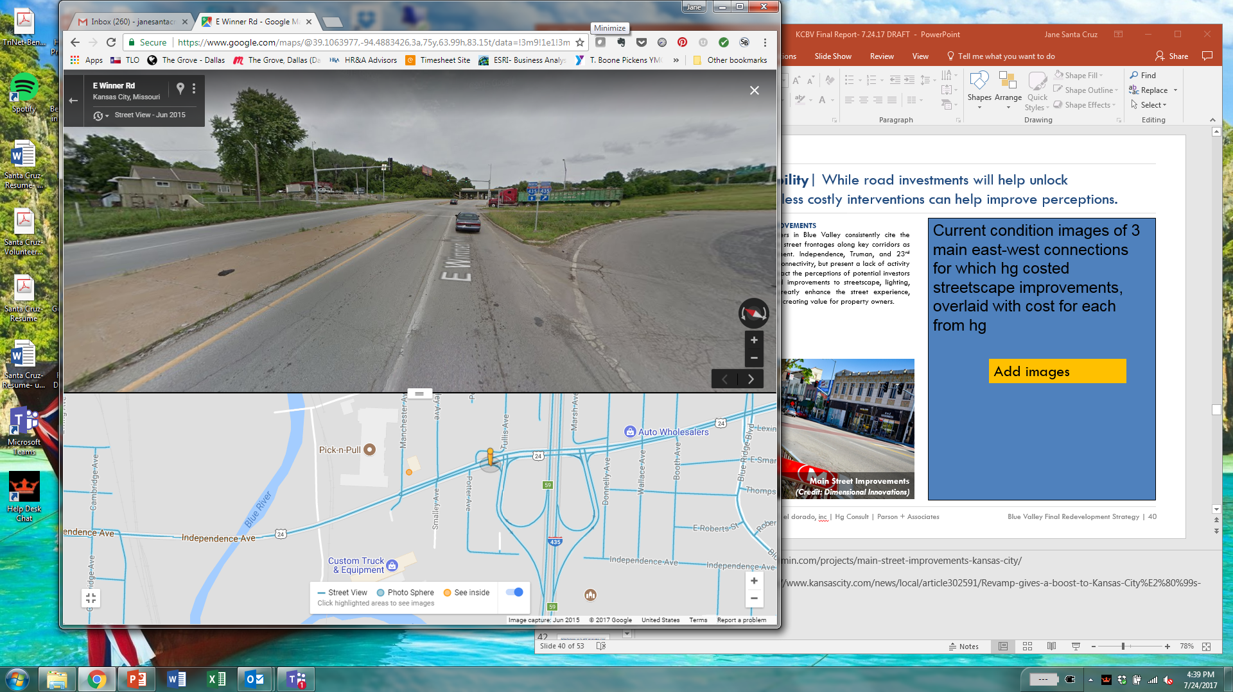
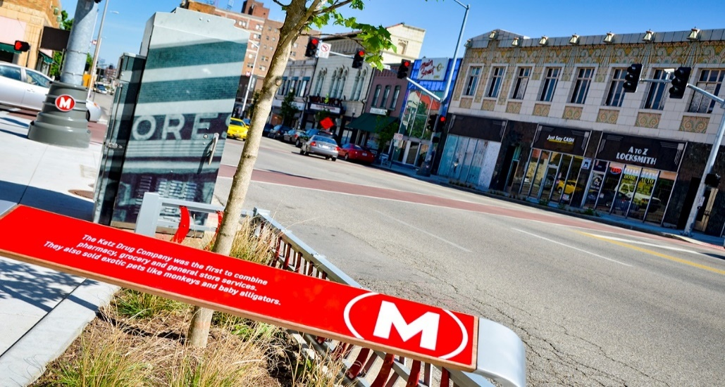
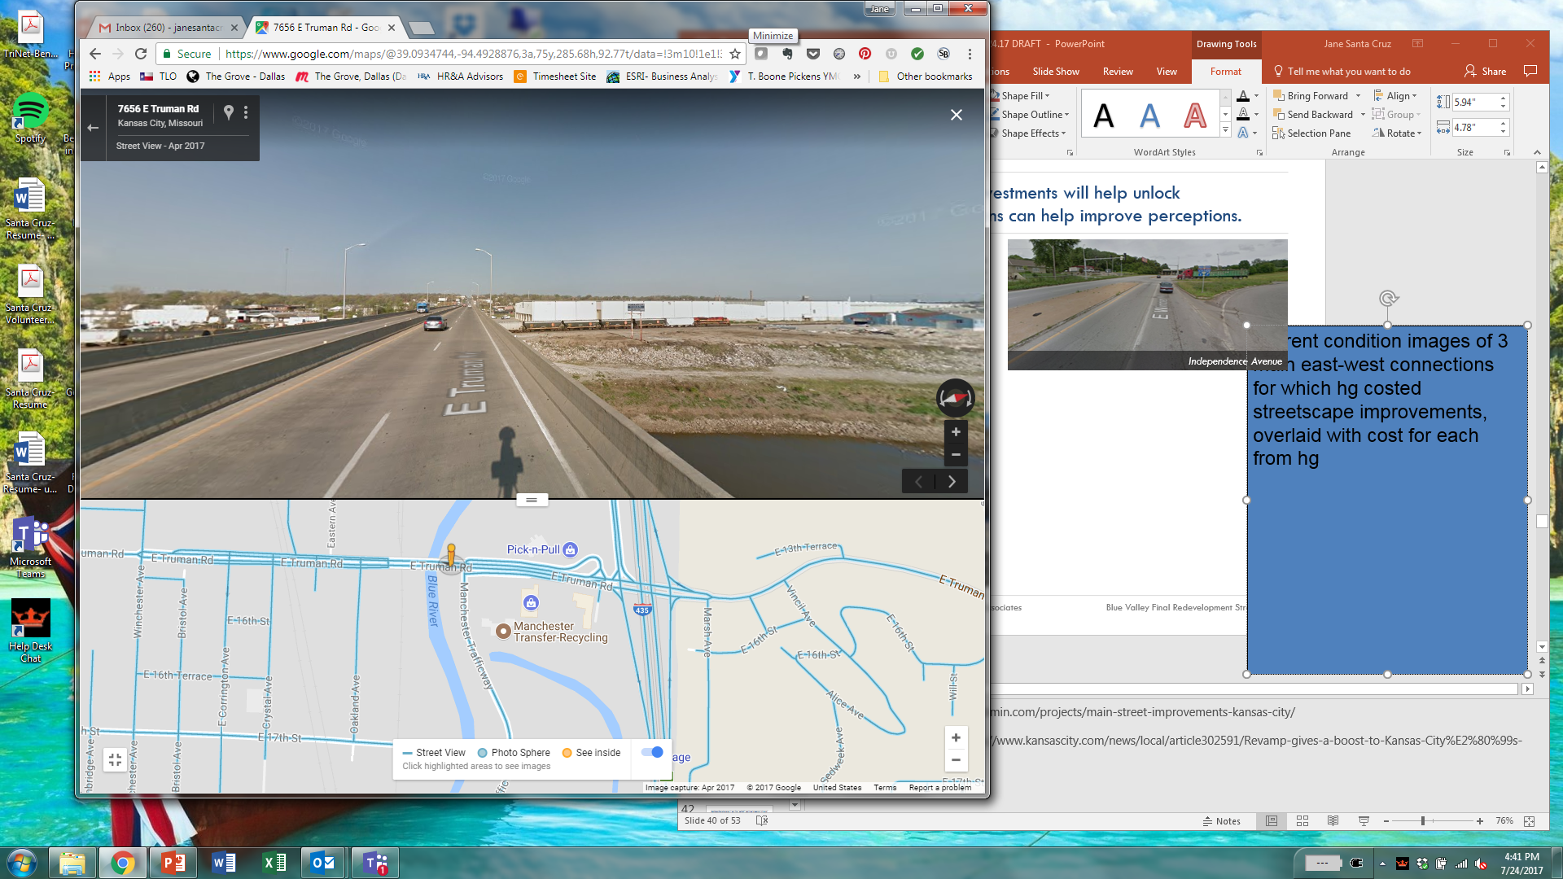

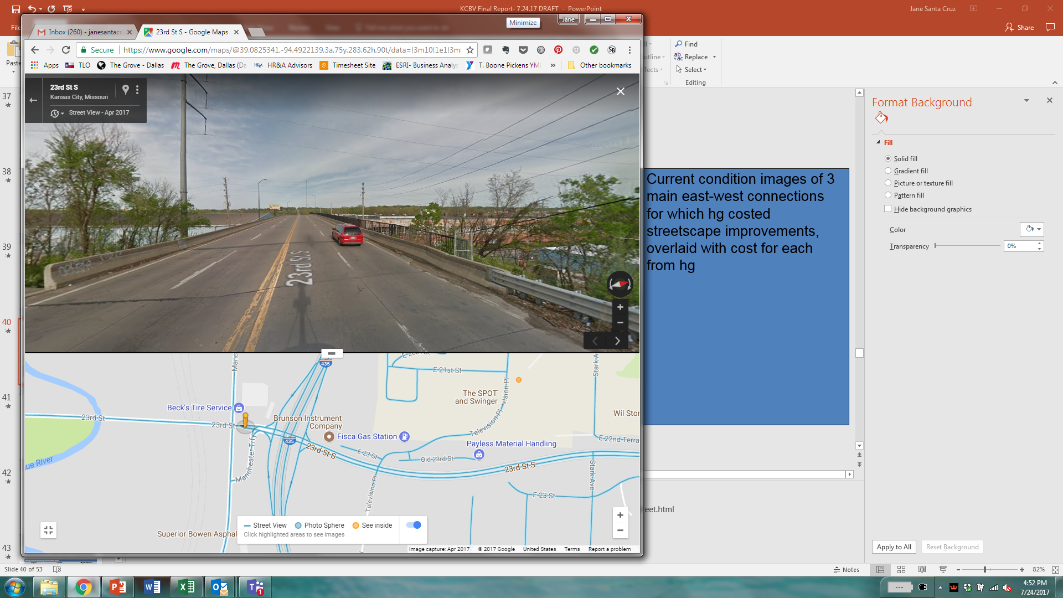
Increase Visibility | Streetscape Investments to Improve Perceptions
Invest in key corridors today…
…to increase investment tomorrow
Independence Avenue
Main Street Improvements
$2.0M
East Truman Road
Create more appealing investment environment future investors
$1.6M
23rd Street
Improve attractiveness and ease of employee access
$1.7M
Improve perceptions of commuters through corridor

Slide 17
Increase Visibility | Shared Responsibility to Communicate the Opportunity
Strategies
Responsibilities
Communicate assets and challenges
KCMO – provide clear investment commitments
Articulate a compelling vision
EDCKC – communicate competitive advantages & incentives to target companies
Highlight recent & planned investment
BVIA – leverage strong leadership for outreach to potential users
Raise awareness of available incentives & tools
Neigh. Assoc. – engage community to ID needs & communicate progress

Slide 18
Facilitate Development | Build an Effective Incentives Strategy
Existing incentives and financing tools have not consistently attracted large-scale new investment in Blue Valley.
Future incentive policies
must be targeted to address costs and risks associated with Blue Valley development. Policies should be:
Select Incentives Applied in Blue Valley
Enhanced Enterprise Zone Fund
(Job Creation & New Investment)
Planned Industrial Expansion Area Abatement
(New Investment)
Predictable
As-of-right, where possible
Targeted
Address specific financial gaps & costs
Factors Limiting Blue Valley Impact
Comprehensive
Packaged to address multiple risk factors
Regionally available
Inadequate gap financing
Limited costs considered
Publicized
Communicated to potential users and developers

Slide 19
Facilitate Development | Enhance and Expand Incentives and Financing Tools
Expand KC, MO Incentives
Expand & deepen existing incentives available to potential Blue Valley developers, such as EEZ
Create New Incentives
Create new incentives for specific purposes:
Provide earnings tax redirection for job creation
Lower criteria for “but-for” test for abatement
Reduce franchise utility tax for new/growing companies
Provide abatement transfer credit for new investments
Additional Opportunities
Explore other targeted mechanisms such as:
Brownfield remediation financing support
Community Improvement District creation

Slide 20
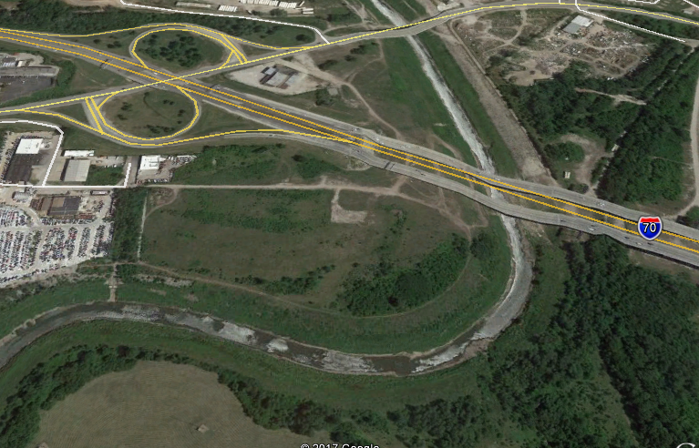
Facilitate Development | Public Investment to Reduce Risk
Public-sector activities support may include:
Acquisition
Public land control for maximum control
Example - Heart Drive-In Site
Other Infrastructure investments
Stormwater infrastructure and/or other needs
Flood Mitigation
Site-specific or district protection
Public Transit
Consideration for new routes to serve employees
Opportunity: 27-acre City site on I-70
Challenge: site in 100-year floodplain
Potential Response: elevate site to unlock disposition and development potential
Public Safety
Address business security concerns
Remediation &
Site Preparation
Site assessment & preparation, elevation
Studies & Site Analysis
Brownfield, traffic, and related studies

Slide 21
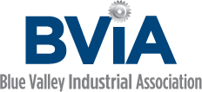


Build Capacity | Proposed Partner Roles & Responsibilities
Establish focused leadership to advance Blue Valley vision through:
  Dedicated staff capacity within the EDC and/or
  New public-private entity to spearhead Corridor redevelopment efforts
Infrastructure Planning & Investment
Lead Blue Valley Redevelopment Entity
EDCKC or New Org.
Public-Private Partnership Building & Business Recruitment
Community Engagement & Outreach
Blue Valley
Neighborhood Association
Workforce Development
Business Recruitment & Retention
Transit Investments & Planning

Slide 22
Implementation Roadmap | Near- and Long-Term Actions to Advance the Vision
Complete brownfield & traffic studies
Initiate design work for new streets
Complete analysis & policy to create Blue Valley incentive package
Create dedicated capacity
Coordinate with Riverfront Industrial Area Plan
Implement neighborhood street improvements
Initiate design work for new streets
Implement regional roadway improvements (Trafficway & Lewis and Clark)
Ongoing site preparation
0-2 Years
3-5 Years
5-10 Years

Slide 23
Blue Valley Redevelopment Opportunity Assessment
Executive Summary
August 2017

Slide 24
APPENDIX

Slide 25
Appendix | Cost Estimates for Road Investments
Cost Estimates
 | Unit Cost Per LF | L.F. | Construction Costs | Design (15%) | Utilities (10%) | Constr. Inspection (5%) | Total Cost
Corridor Streetscape Improvements
Independence / Winner | $300 | 5000 | $1,500,000 | $225,000 | $150,000 | $75,000 | $1,950,000
Truman | $300 | 4000 | $1,200,000 | $180,000 | $120,000 | $60,000 | $1,560,000
23rd Street | $300 | 4300 | $1,290,000 | $193,500 | $129,000 | $64,500 | $1,677,000
Road Improvements
North & Central
1 | $1250 | 1500 | $1,875,000 | $281,250 | $187,500 | $93,750 | $2,437,500
2 | $1250 | 6150 | $7,687,500 | $1,153,125 | $768,750 | $384,375 | $9,993,750
3 | $1250 | 2450 | $3,062,500 | $459,375 | $306,250 | $153,125 | $3,981,250
4 | $1250 | 3100 | $3,875,000 | $581,250 | $387,500 | $193,750 | $5,037,500
5 | $1250 | 2450 | $3,062,500 | $459,375 | $306,250 | $153,125 | $3,981,250
*6 | $1500 | 10500 | $19,500,000 | $2,925,000 | $1,950,000 | $975,000 | $25,350,000
7 |  |  | $33,000,000 | $4,950,000 | $3,300,000 | $1,650,000 | $42,900,000
North & Central Total |  |  |  |  |  |  | $93,681,250
South
8 | $1250 | 9500 | $11,875,000 | $1,781,250 | $1,187,500 | $593,750 | $15,437,500
9 | $1250 | 4250 | $5,312,500 | $796,875 | $531,250 | $265,625 | $6,906,250
10 | $1250 | 3200 | $4,000,000 | $600,000 | $400,000 | $200,000 | $5,200,000
South Total |  |  |  |  |  |  | $27,543,750
* Assumes 9,500 Lin. Ft. of Roadway, 1,000 Lin. Ft. of Bridge at $100/S.F., plus one signal.
Source: Hg Consult Analysis

Slide 26
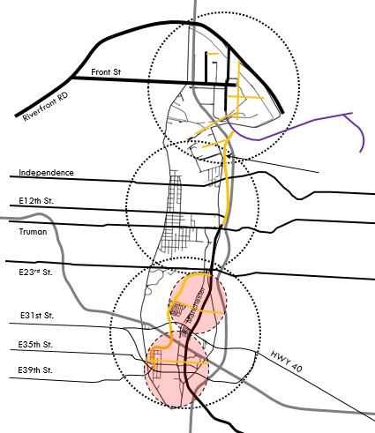
Cost Estimates for Road Investments
 | Total Cost | Notes
Corridor Streetscape Improvements
Independence / Winner | $2.0M | Limits Winchester through I-435 interchange
Truman | $1.6M | Limits Winchester through I-435 interchange
23rd Street | $1.7M | Limits Blue Valley Park Rd through I-435 interchange
Road Improvements
North & Central
1 | $2.44M | At-grade RR crossing
2 | $10.0M | Cooperation needed from KCP&L
3 | $4.0M | Cooperation needed from Bayer
4 | $5.0M | At-grade RR crossing
5 | $4.0M | At-grade RR crossing.
*6 | $25.3M | Difficult alignment options, Right of Way and cooperation required from multiple parcels
7 | $43.0M | Lewis & Clark Extension (LCE) project. Status on hold, ROW plans submitted.
South
8 | $15.4M | 2 at-grade RR crossings
9 | $7.0M | At-grade RR crossing
10 | $5.2M | At-grade RR crossing
1
2
Lewis & Clark Extension
3
4
7
5
Extend Manchester Trafficway
6
8
9
10

